Slide 1




GYM MANAGEMENT (Level Up Progress) by SAM ABISHEK V (43130373)

Slide 2
Introduction
The Gym Management System is a web application designed to simplify gym operations and provide users with personalized fitness experiences. It integrates authentication, BMI calculation, diet, and workout plans

Slide 3
Objective
To develop a comprehensive platform that enables gyms to manage users, diet plans, and workout routines while offering personalized fitness tracking and progress visualization.

Slide 4
Literature Review
Existing systems focus on either gym management or fitness tracking. Our approach combines both, leveraging MERN stack technologies, JWT authentication, and AI-based recommendations.

Slide 5
Methodology-Model
The project is built with a Node.js and Express.js backend using MongoDB for data storage, and a React frontend set up with Vite and styled with Tailwind CSS. It implements secure authentication with JWT and bcrypt and includes features such as a BMI calculator, diet and workout plan generation, an admin dashboard, and a fully responsive design for seamless use across devices.

Slide 6
Expected Outcomes
This platform provides an easy-to-use system for gym users and admins, offering personalized health and fitness plans, improved user engagement and retention, and data-driven insights for gym administrators.

Slide 7
Future Scope
The platform features integration with wearable fitness trackers, real-time notifications and reminders, social sharing and community features, a dedicated mobile app version, and online payment and subscription handling for a comprehensive fitness experience.

Slide 8
Applications
The system offers gym user management with personalized diet and workout recommendations, along with BMI and progress tracking. It provides admin analytics and subscription monitoring and is fully accessible on desktop, tablet, and mobile for a seamless multi-device experience.

Slide 9
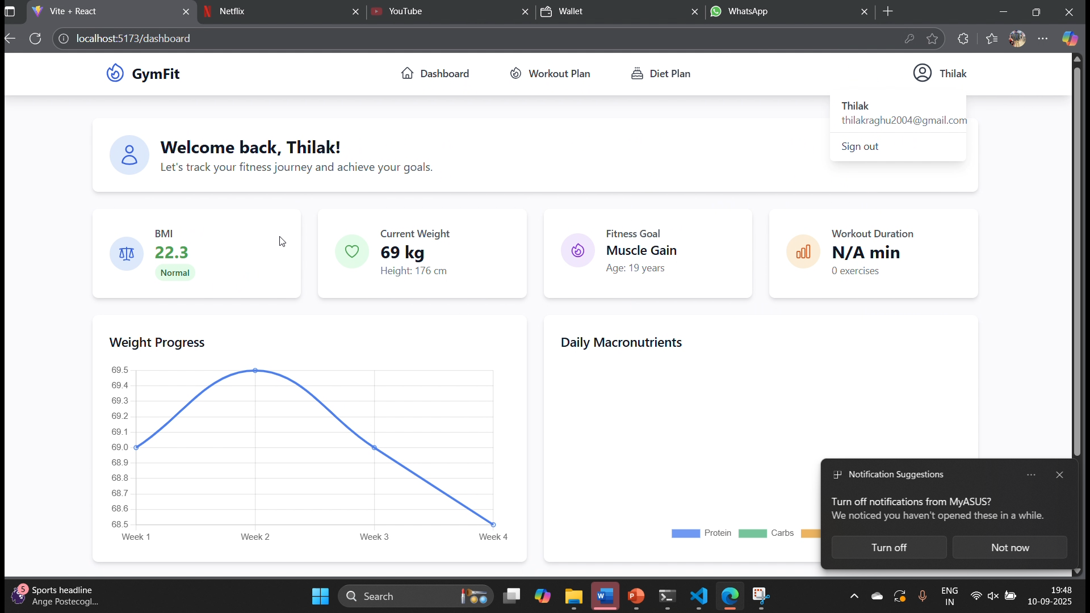
Project Screenshot

Slide 10
Conclusion
The Gym Management System enhances fitness experiences by combining gym management with AI-driven personalization. It empowers both users and administrators through secure, scalable, and responsive technology.

Slide 11
thank you

